Slide 1
No Target in Ocean Beach! Community Forum Wednesday – October 11, 2017
A Community discussion on the importance of supporting, and the obstacles of maintaining, a local Main Street and a strong local economy.

Slide 2
“It’s a Done Deal” NOT!
Last Target Public Statement:
Statement given to Channel 8 August 30th 2017
Target continues to do our due diligence to engage and listen with businesses, leaders and officials in the Ocean Beach community for a potential Target store location. Conversations are ongoing and nothing is final.
What I can share is that Target has an agreement with the landlord that allows Target the flexibility to proceed or not proceed with a potential store at this Ocean Beach location.
What we have previously shared in community meetings earlier this month still stands, which is that we’re continuing to listen to community feedback that could inform Target’s plans for a small-format store in Ocean Beach. At this point in the process, there is nothing official to share about new store plans.

Slide 3
Target in Ocean Beach is in direct opposition to the City Adopted Ocean Beach Community Plan

Slide 4
OCEAN BEACH Community Plan and Local Coastal Program Adopted on November 9, 2015
By the City of San Diego
Our Community’s Representation at the time the Plan was Adopted :
Mayor: Kevin Faulconer
City Council: Lorie Zapf, District 2

Slide 5
Ocean Beach Community Plan Chapter 1: Introduction
"The Ocean Beach Community Plan and Local Coastal Program identifies Ocean Beach as a small-scale coastal village.“
"Encourage smart growth development that is transit-, pedestrian-, and bike-friendly."
"Urban Design: Foster the small-scale character of Ocean Beach, maintain an unobstructed and accessible beach frontage, and promote a pedestrian-friendly community."

Slide 6
Ocean Beach Community Plan Chapter 2: Land Use Element
"Ocean Beach includes a wide diversity of small-scale locally-owned business establishments."
Recommendation 2.2.2: Maintain and enhance commercial districts in Ocean Beach by promoting locally-owned businesses.

Slide 7
Ocean Beach Community Plan Chapter 3: Mobility Element
"The policies are intended to mitigate impacts associated with automobiles while enhancing desirable outcomes associated with the City of Villages growth strategy in terms of bikeability, walkability and pedestrian orientation."
"Maintain and enhance the pedestrian and bicycle interface with beach and commercial areas and the neighborhoods by ensuring that vehicular access to such areas does not compromise pedestrian and bicycle safety."

Slide 8
Last Target Public Statement:
Statement given to Channel 8 August 30th 2017
Target continues to do our due diligence to engage and listen with businesses, leaders and officials in the Ocean Beach community for a potential Target store location. Conversations are ongoing and nothing is final.
What I can share is that Target has an agreement with the landlord that allows Target the flexibility to proceed or not proceed with a potential store at this Ocean Beach location.
What we have previously shared in community meetings earlier this month still stands, which is that we’re continuing to listen to community feedback that could inform Target’s plans for a small-format store in Ocean Beach. At this point in the process, there is nothing official to share about new store plans.

Slide 9
Support Local Independent Business!!
The impact of Target in Ocean Beach will be detrimental to our local independent businesses’ struggle to survive on our main street and the local economy of Ocean Beach will suffer.
Small Local Independent Businesses are unable to sustain extreme rent increases, and they are unable to compete with the low prices of mega-corporations due to the inequality of “buying power”.

Slide 10
A Strong Local Economy!
Independent locally-owned businesses re-circulate a far greater percentage of revenue locally compared to absentee-owned businesses.
How does this Work?
1. Directly, when spending is done by a business in the local economy to operate the business, including inventory, utilities, equipment and pay to employees.
2. Indirectly, as dollars the local business spent at other area businesses re-circulate.
3. Consumer spending that happens as employees, business owners and others spend their income in the local economy.

Slide 11
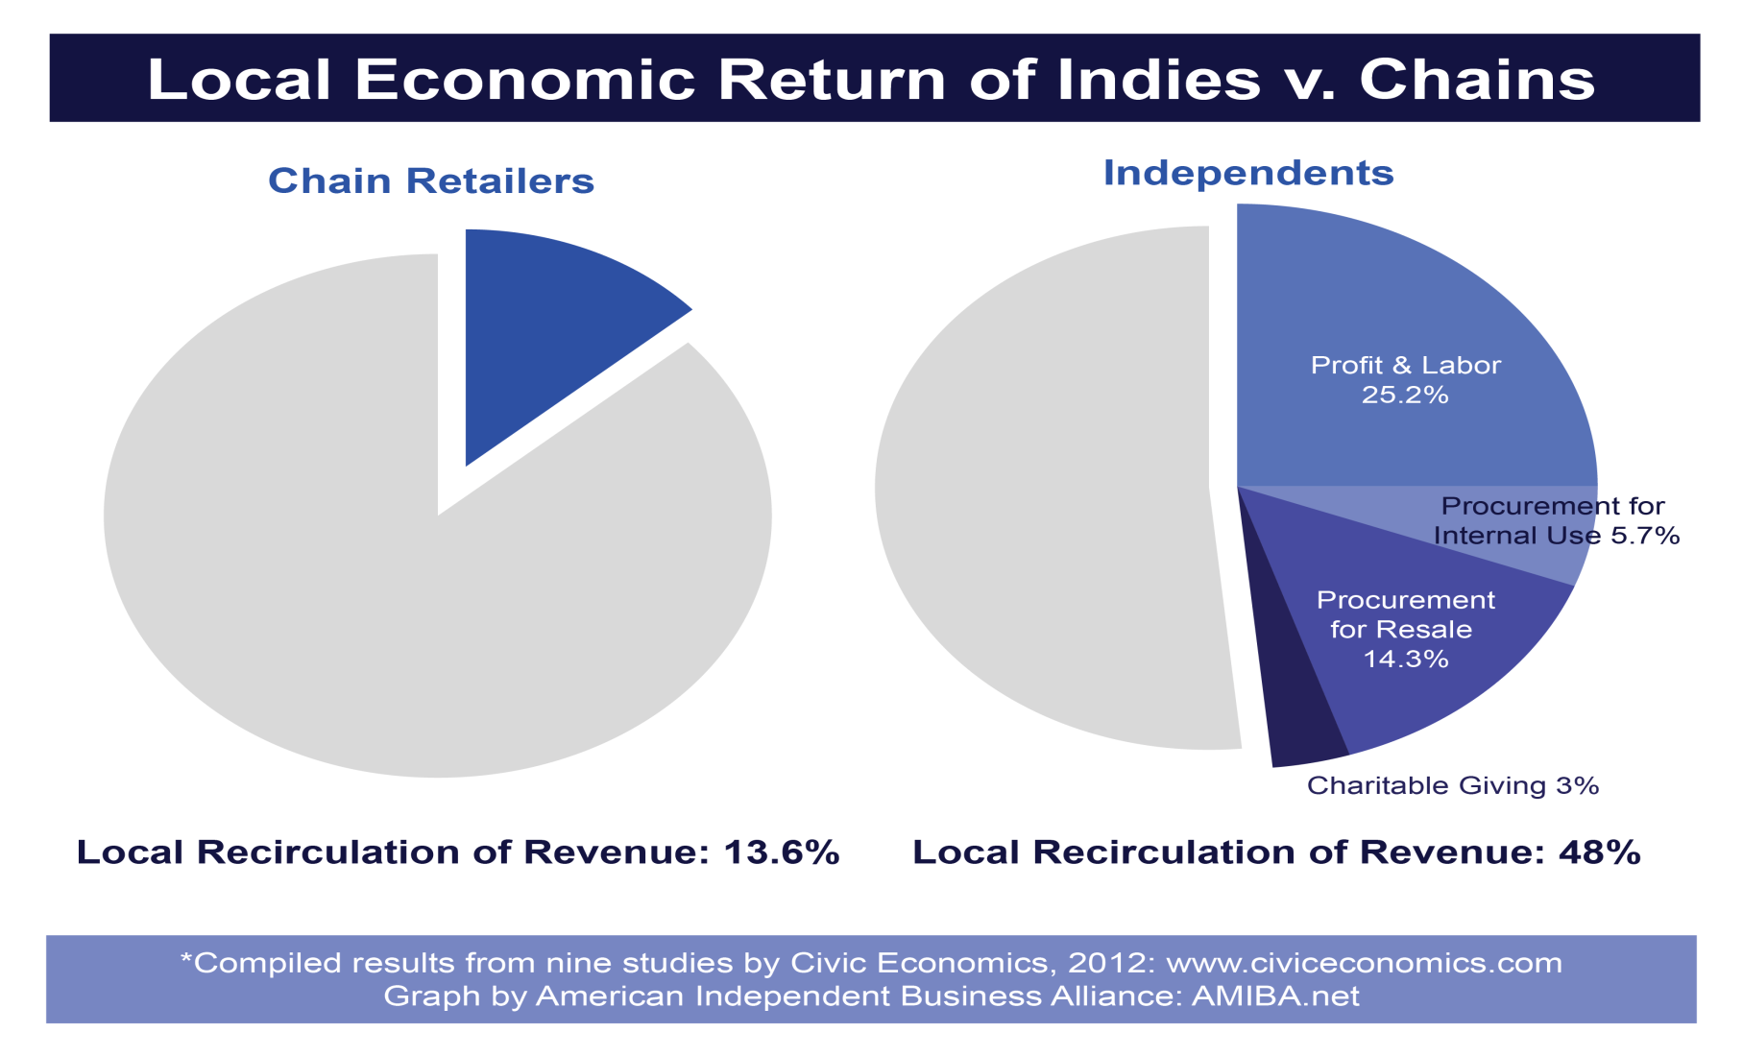
Since 2002, a growing number of studies have quantified the local economic benefits delivered by independent businesses, demonstrating locally-owned independent businesses return much more of each dollar in revenue to their communities than chains (i.e. the local premium)

Slide 12
Just a few reasons to Support Local!
You are helping build Community & protect the unique character!
You are strengthening your Local Economy!
Small Businesses generate more tax revenue per sales dollar.
Small Businesses create greater overall choice for all of us!
Small Businesses create jobs through their own employment and those to which they are the customers (i.e. local printers, accountants, wholesalers, farms, attorneys, etc….expanding opportunities for local entrepreneurs!

Slide 13
Other Communities have successfully proven that Supporting & Protecting Local Businesses creates a strong and vibrant Main Street!
Austin, Texas
Portland, Oregon
La Plata County, Colorado
Arcata, California
Port Jefferson, New York
Boulder, Colorado
Ithaca, New York
Carmel-by-the-Sea, Calif.
Bellingham, Washington
Sanibel, Florida
Visit: www.amiba.net & ilsr.org
for more information ☺

Slide 14
OB
We are confident that the Ocean Beach Community has enough creativity and passion to protect the lifestyle we All Love and come up with a better, positive solution for our Community other than a Target.
Get Involved! Participate! ☺

Slide 15
Last Target Public Statement:
Statement given to Channel 8 August 30th 2017
Target continues to do our due diligence to engage and listen with businesses, leaders and officials in the Ocean Beach community for a potential Target store location. Conversations are ongoing and nothing is final.
What I can share is that Target has an agreement with the landlord that allows Target the flexibility to proceed or not proceed with a potential store at this Ocean Beach location.
What we have previously shared in community meetings earlier this month still stands, which is that we’re continuing to listen to community feedback that could inform Target’s plans for a small-format store in Ocean Beach. At this point in the process, there is nothing official to share about new store plans.

Slide 16
OB?
TAKE ACTION!
☺

Slide 17
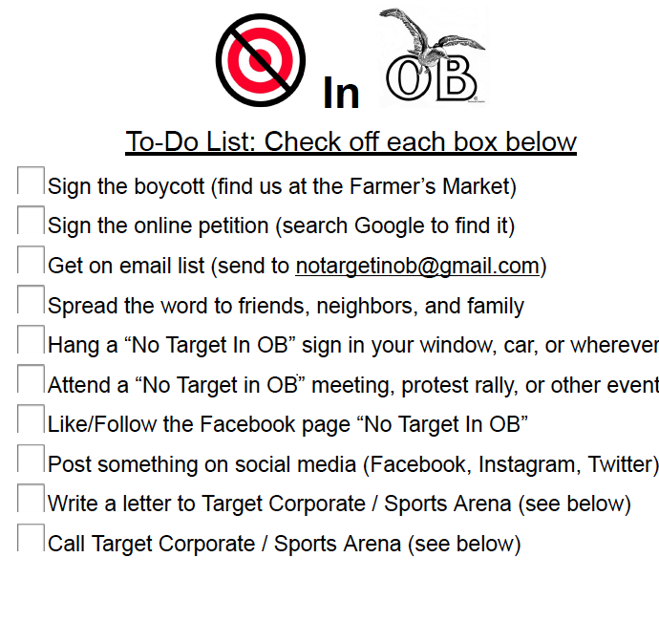
TAKE ACTION!

Slide 18
Boycotts Work!
Target is a Mega Corporation. They are legally bound to make money for their Shareholders.
That is why they exist.
They are not legally bound to care about the sentiments of a small Community!
That is why BOYCOTTS WORK!
Let’s promote a Boycott against Target locally, nationally, and even internationally!
Spread the Word!

Slide 19
“We’re Against the Wal in Greenfield” defeats re-zoning for Wal-Mart in Mass
After a short campaign of lawn signs, newspaper advertisements and radio talk-show forums, voters went to the polls and overturned the Town Council's vote that approved Wal-Mart!
It’s not economic development. It’s economic displacement. - Al Norman Sprawl Busters

Slide 21
Until Target says “No” to OB, We say “No” to Target! Boycott Target!

Slide 22
OB?
TAKE ACTION! ☺
Take Action on Social Media!
#notargetinob
Website: http://notargetinob.weebly.com
Email: notargetinob@gmail.com
@notargetinob

Slide 23
Last Target Public Statement:
Statement given to Channel 8 August 30th 2017
Target continues to do our due diligence to engage and listen with businesses, leaders and officials in the Ocean Beach community for a potential Target store location. Conversations are ongoing and nothing is final.
What I can share is that Target has an agreement with the landlord that allows Target the flexibility to proceed or not proceed with a potential store at this Ocean Beach location.
What we have previously shared in community meetings earlier this month still stands, which is that we’re continuing to listen to community feedback that could inform Target’s plans for a small-format store in Ocean Beach. At this point in the process, there is nothing official to share about new store plans.

